Slide 1
Conformational testing of nitrophthalic acids using quantum chemistry and experimental methods
Supervisor
Prof. Aleksander Filarowski
Author
Kinga Jóźwiak
University of Wroclaw

Slide 2
CONTENTS
Theoretical introduction
Experimental and computational data
Conclusions
Bibliography

Slide 3
Theoretical introduction
The most important information related to the experiment

Slide 4
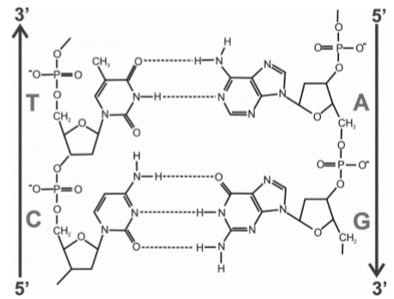
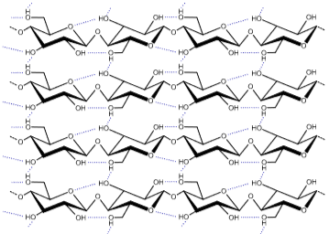
HYDROGEN BOND
A
H
X

Slide 5
X – H ---- A
Hydrogen bond donor
Hydrogen bond acceptor
hydrogen bonds form typically between polar or polarized X –H bonds and electronegative acceptor atoms
it possesses a signiﬁcant electrostatic character

Slide 6
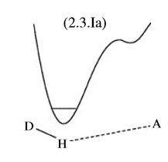
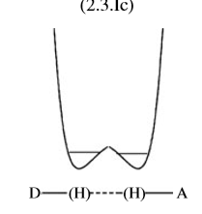
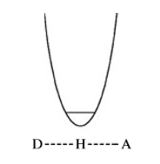
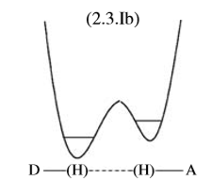
H-bond classification by physical properties
1
2
3
4
aSW-HB
aDW-MB
sDW-LB
sSW-NB
E

Slide 7
Tautomeric equilibrium

Slide 8
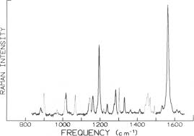
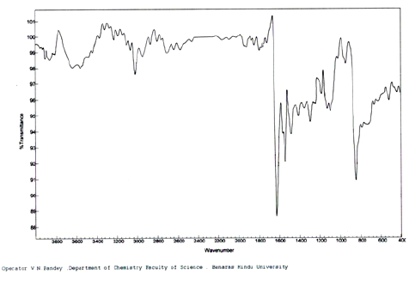
IINS
Raman
IR
Spectroscopic research of compounds with hyndrogen bonds

Slide 9
RAMAN
IR
IINS
selection rules (complementary method to IR)
reasearching energy levels of the molecule by observing the frequencies present in the radiation scattered by the molecule
vibrations of molecules are active in the Raman spectrum if they are accompanied by a change in the polarization of the molecule
solid, liquid, gaseous samples
selection rules
the ability to register spectra in all states of matter in a wide range of temperatures
oscillations determine the formation of different absorption bands
the bands parallel to vibrations that cause changes in the dipole moment of the molecules
low intensity for the low freq models
solid, liquid, gaseous samples
no selection rules connected with the symmetry of the molecule
probability of the e.t. depends on the cross-section and on the amplitude of the vibration of an particular atom
resolution does not exeed 2-3%
solid state at low temperature – sample
useful to the studies of molecular vibrations of low frequency internal modes

Slide 10
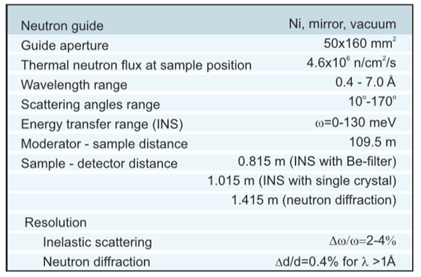
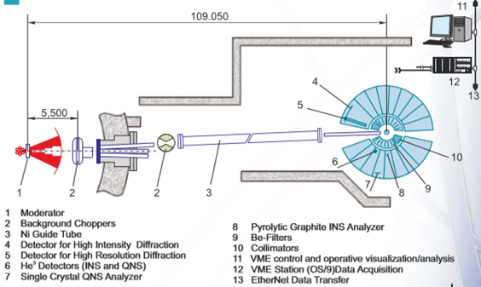
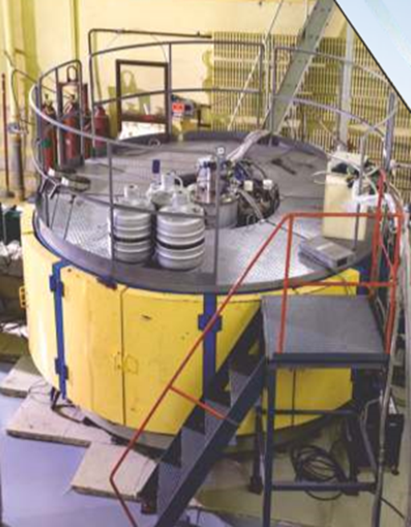
NERA

Slide 11
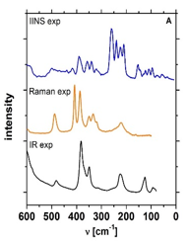
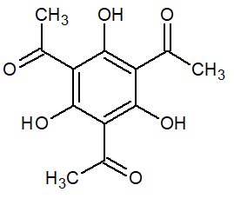
Why we have to analyze three types of spectra ?
IINS (1100 – 50 cm⁻¹, T=10 K),
MIR i FIR (4000 – 50 cm⁻¹; 300 K < T 5 K),
Raman (T=300 K)

Slide 12
Experimental and computational
data

Slide 13
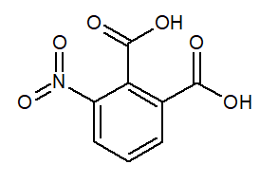
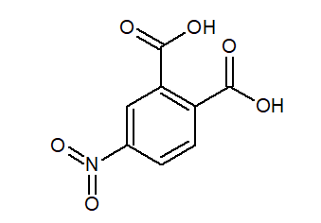
Analyzed chemical compounds
3-nitrobenzene-1,2-dicarboxylic acid
(3-nitrophthalic acid)
4-nitrobenzene-1,2-dicarboxylic acid
(4-nitrophthalic acid)

Slide 14
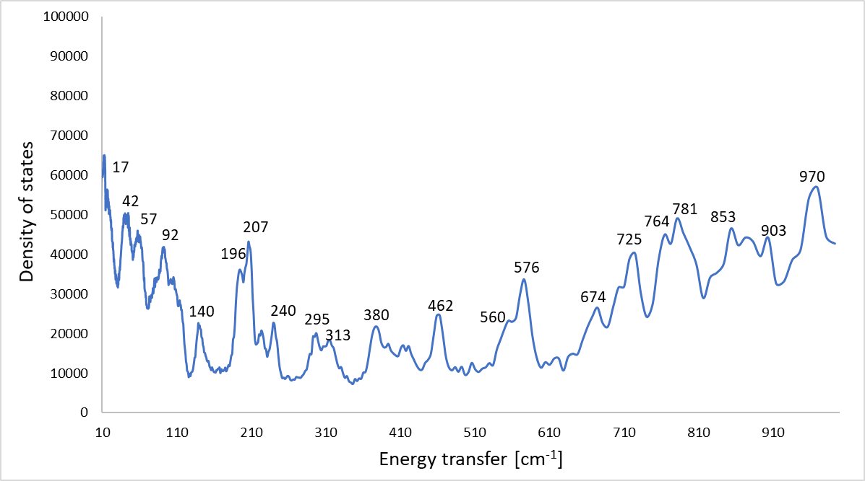
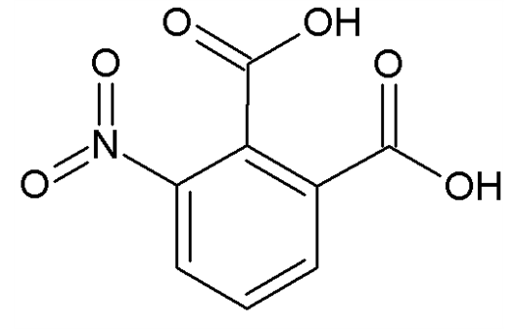
Spectrum prepared in NuVis
5 K

Slide 15
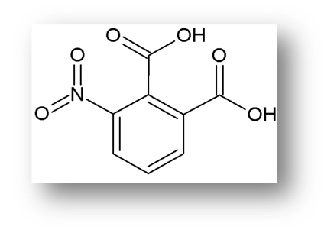
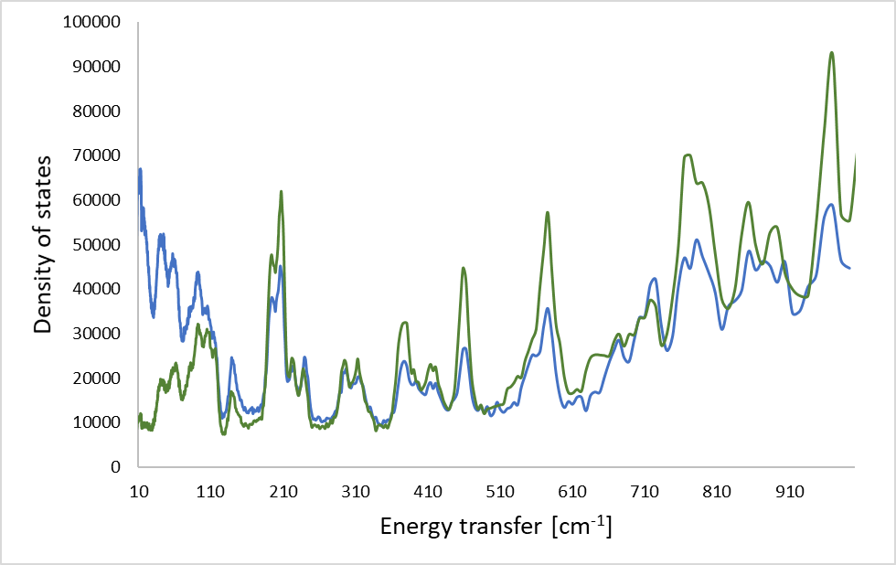
Spectrum prepared in NuVis, 5K
ν_{δ}(OH) – hydrogen bridge

Slide 16
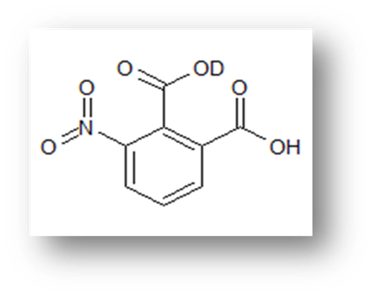
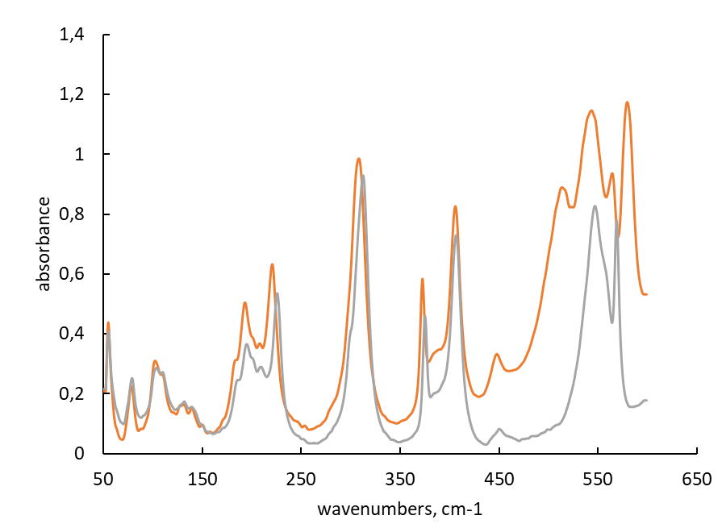
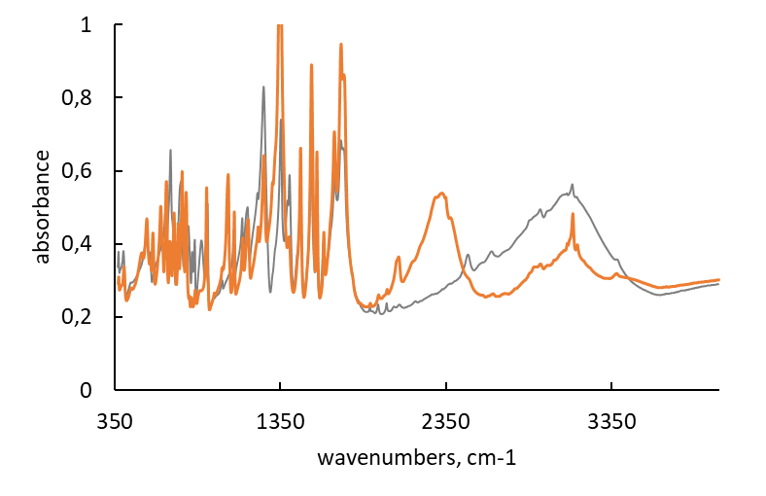
IR
FIR
MIR
ν(OD)
ν(OH)
ν(OH)
γ(OH)
OD
OH

Slide 17
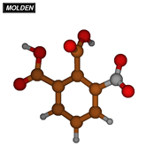
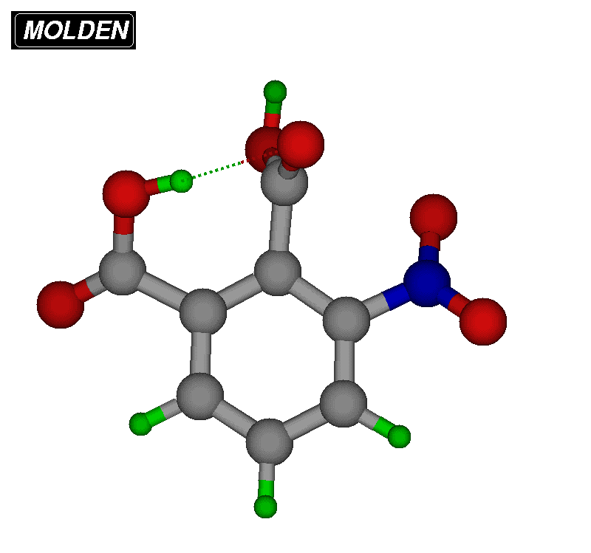
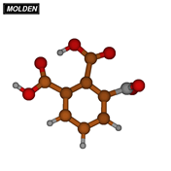
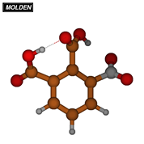
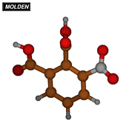
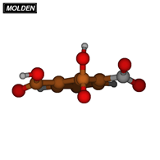
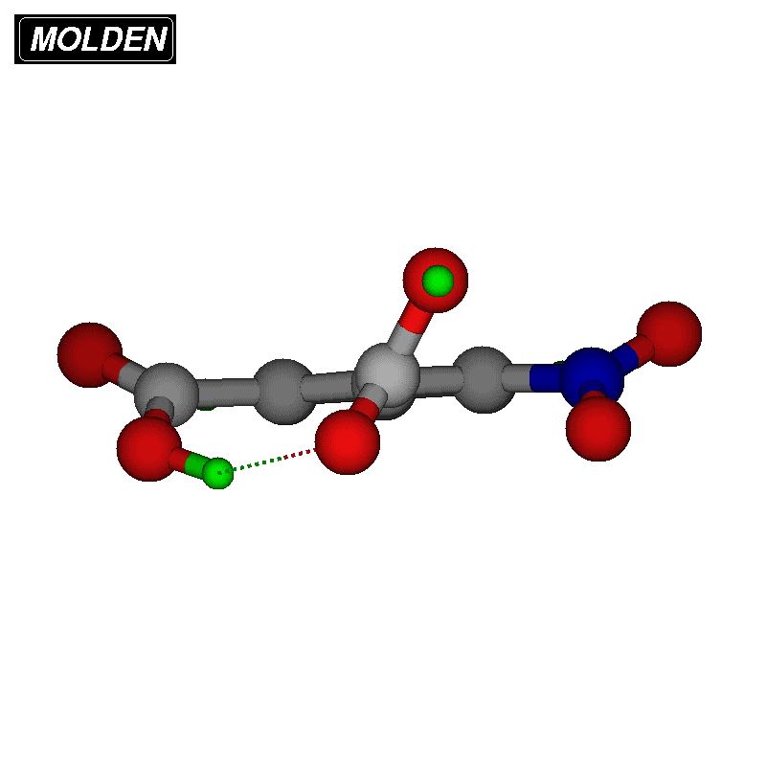
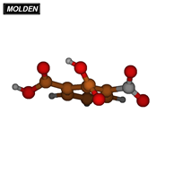
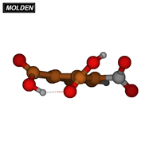
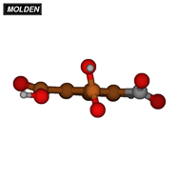
3-nitrophthalic acid conformers
E(I)=0 kcal/mol
E(II)=2,35 kcal/mol
E(III)=3,93 kcal/mol
E(IV)=4,67 kcal/mol
E(V)=7,15 kcal/mol

Slide 18
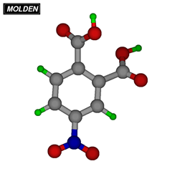
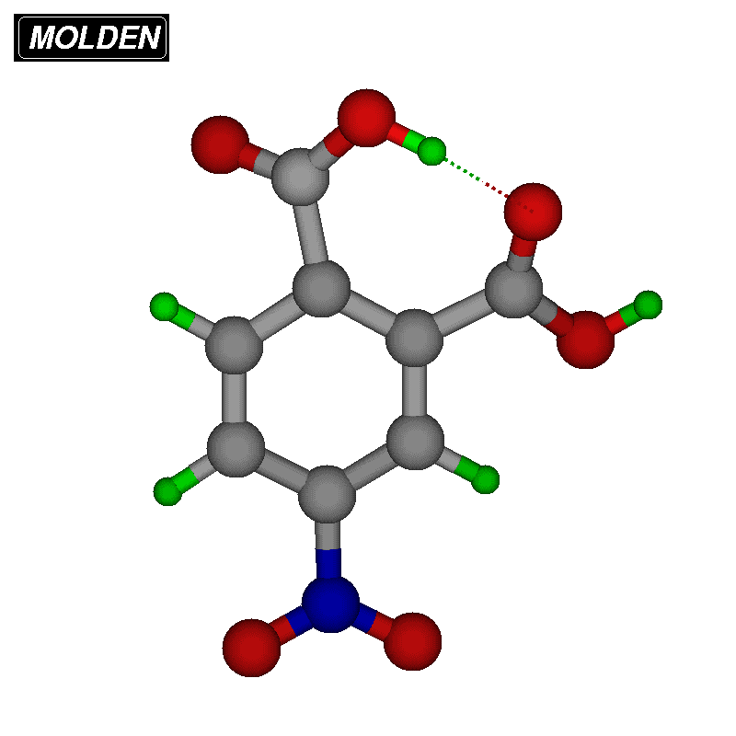
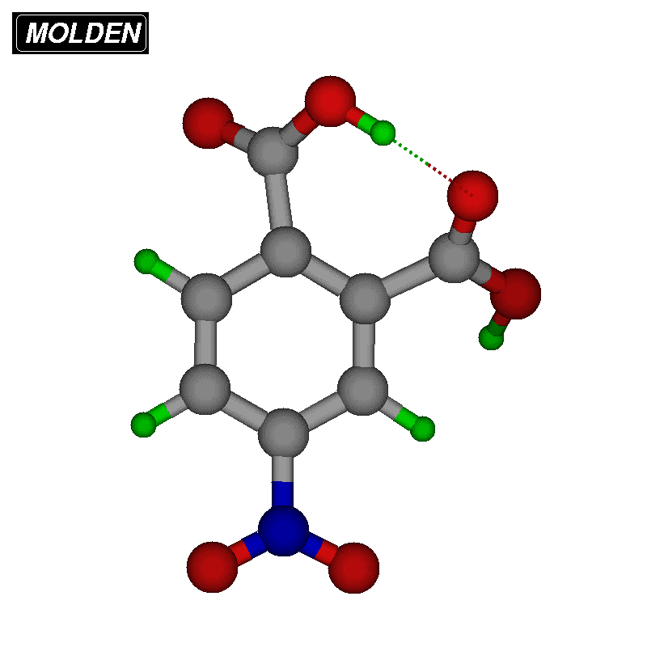
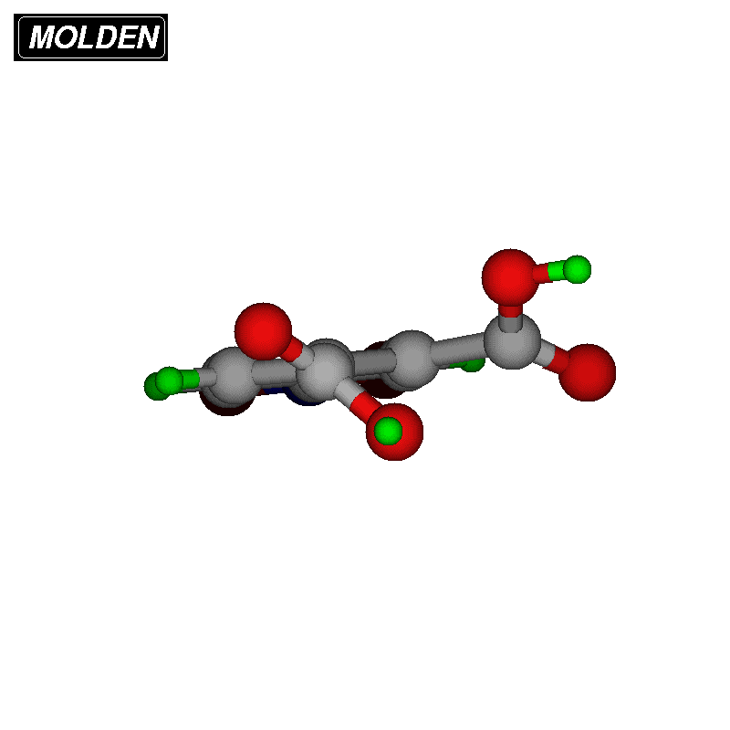
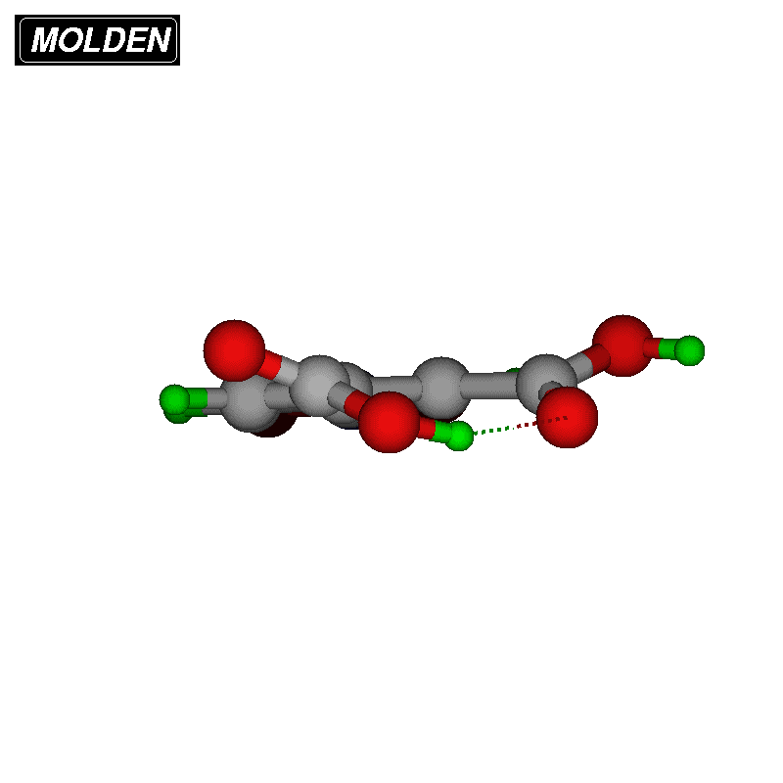
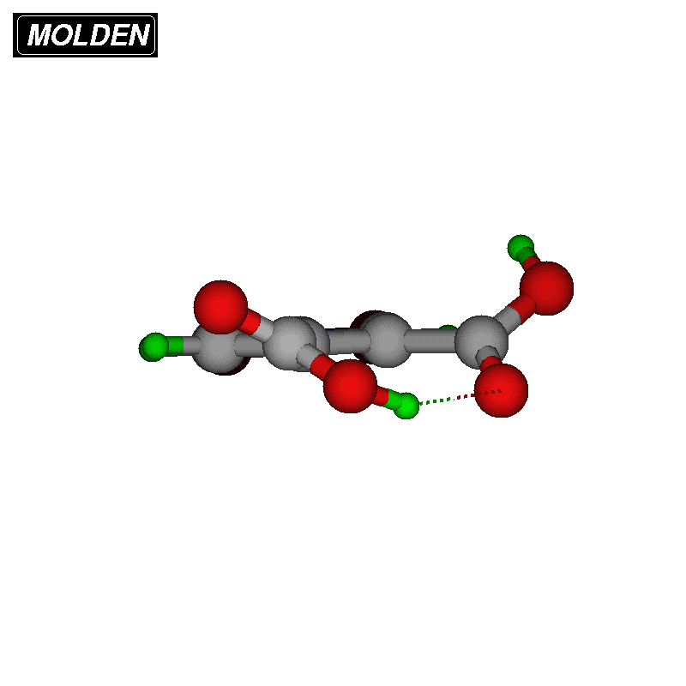
4-nitrophthalic acid conformers
E(I)=0 kcal/mol
E(II,III)=0,51 kcal/mol
E(IV)=6,52 kcal/mol

Slide 19
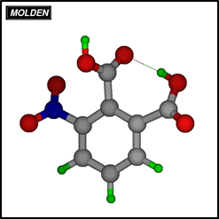
Elongation of the hydrogen bond
3-nitrophthalic acid
d(OH) [Å]

Slide 20
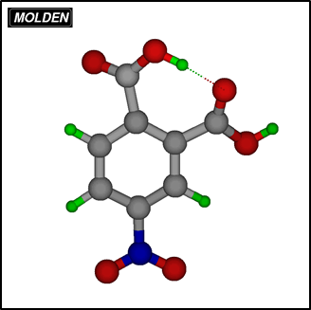
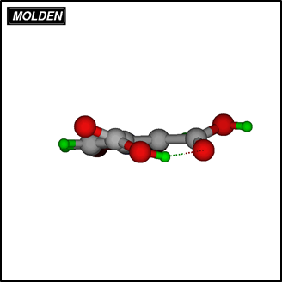
Elongation of the hydrogen bond
4-nitrophthalic acid
d(OH) [Å]

Slide 21
Conclusions

Slide 22
Hydrogen bond is so important electrostatic interactions for the science, people, their health and all the world
To receive full of the information about the chemical compound with hydrogen bonding it is necessary to use three experimental methods IR, Raman, IINS
Quantum computations allow you to get a lot of information about the structure and interactions
By changing the positioning of substituents or individual atoms we get seemingly the same compounds but with different interesting properties

Slide 23
Bibliography
L. Sobczyk, D. Chudoba, P. M. Tolstoy, A. Filarowski, Some Brief Notes on Theoretical and Experimental Investigations of Intramolecular Hydrogen Bonding, Molecules 2016,21,1657
Prof. Petri M. Pihko, Hydrogen Bonding in Organic Synthesis, WILEY-VCH, 2009
G. Gilli, P. Gilli, The nature of the hydrogen bond, Outline of z Comprehensive Hydrogen Bond Theory, IUCr, Oxford Scientific Publications, 2009
S.W. Lovesey, Theory of Neutron Scattering from Condensed Matter, Vol. 2, International Series of monographs, Oxford Scientific Publications, 2003
Y. Marechal, The Hydrogen Bond and the Water Molecule, The physics and chemistry of water, aqueous and bio media, 2007
A. Kohen, H. Limbach, Isotope Effects in Chemistry and Biology, Taylor & Francis Group, 2006

Slide 24
Thank you for your attention

